Slide 1
UML (Unified Modeling Language) Diagrams
Software Engineering
Neil Toporski

Slide 2
1 Use Case Diagrams
UML Diagram Types
Use Case Diagrams

Slide 3
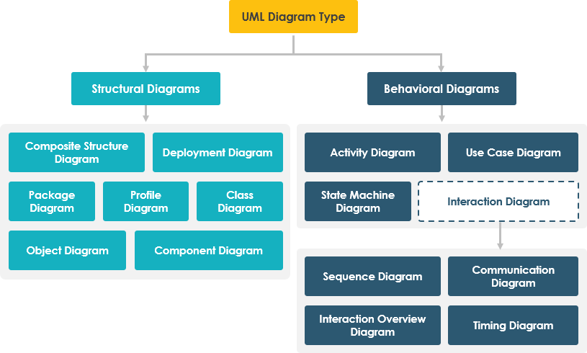

1.1 Unified Modeling Language (UML) Diagram Type
Notes:
Checkmarks are what we’re going to cover
Make sense with the team and sponsor of where we’re going, status, etc.
Used more as discussion points rather than concrete model

Slide 4
1.2 Use Case Diagrams
Purpose
Use case diagrams are typically developed in the early stage of development and people often apply use case modeling for the following purposes:
Visualize system architecture
Establish the requirements of a system
Validate a systems architecture
Drive implementation and generate test cases
Developed by analysts together with domain experts

Slide 5
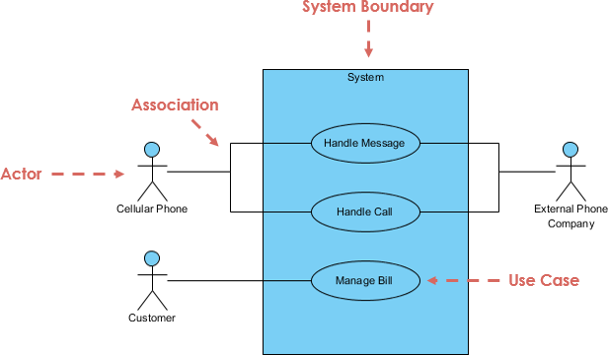
Parts of Use Case Diagrams
Actors
System
Use Case
Associations
Notes:
System – what we’re building, inputs and outputs
Use cases – what the different steps are
Associations – what happens in certain sequences

Slide 6
Parts of Use Case Diagrams
Actor
Someone or something interacts with use case (system function). Resides outside the system.
Named by noun. (Type or Categories: Customer not “John”)
An actor is a user or anything else that exhibits behavior when interacting with the system. The actor could be another system, a piece of hardware, or an entire organization. Similar to the concept of user, but a user can play different roles
Actor triggers use case(s).
Actor has a responsibility toward the system (inputs), and Actor has expectations from the system (outputs).

Slide 7

Parts of Use Case Diagrams
Actor Types
Primary: Initiates the use of the system. i.e. The customer.
Secondary: More reactionary. i.e. the Bank acts only once the customer does something.
Primary actors should be on the left of the system whereas secondary actors should be on the right.
Customer
Bank
Notes:
Primary: typically the user

Slide 8

Parts of Use Case Diagrams
Use Case
System function (process - automated or manual)
Named by verb + Noun (or Noun Phrase).
i.e. Do something
Each Actor must be linked to a use case, while some use cases may not be linked to actors.

Slide 9

Parts of Use Case Diagrams
Communication Link (Associations)
The participation of an actor in a use case is shown by connecting an actor to a use case by a solid link.
Actors may be connected to use cases by associations, indicating that the actor and the use case communicate with one another using messages.
Association Link:

Slide 10
Parts of Use Case Diagrams
System: Whatever you are developing.
Boundary of System
The system boundary is potentially the entire system as defined in the requirements document.
For large and complex systems, each module may be the system boundary.
Can form a system boundary for use cases specific to each of these business functions.
The entire system can span all of these modules depicting the overall system boundary.

Slide 11


Structuring Use Case Diagram with Relationships
Include:
The include relationship adds additional functionality not specified in the base use case. The <<Include>> relationship is used to include common behavior from an included use case into a base use case in order to support the reuse of common behavior.
Extends:
A behavior extends another if it is in addition to but not necessarily part of the behavior.
Notes:
Extends: kind of like a non-functional requirement
Nice to have, not necessary for the system to work

Slide 12
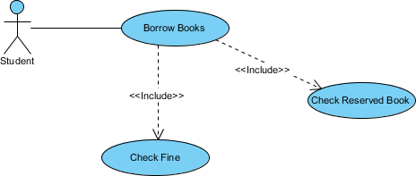
Include Relationship

Slide 13

Extend Relationship
In this case, The <<extend>> relationship is used to include optional behavior from an extending use case in an extended use case.
Notes:
Not necessary to get a book

Slide 14
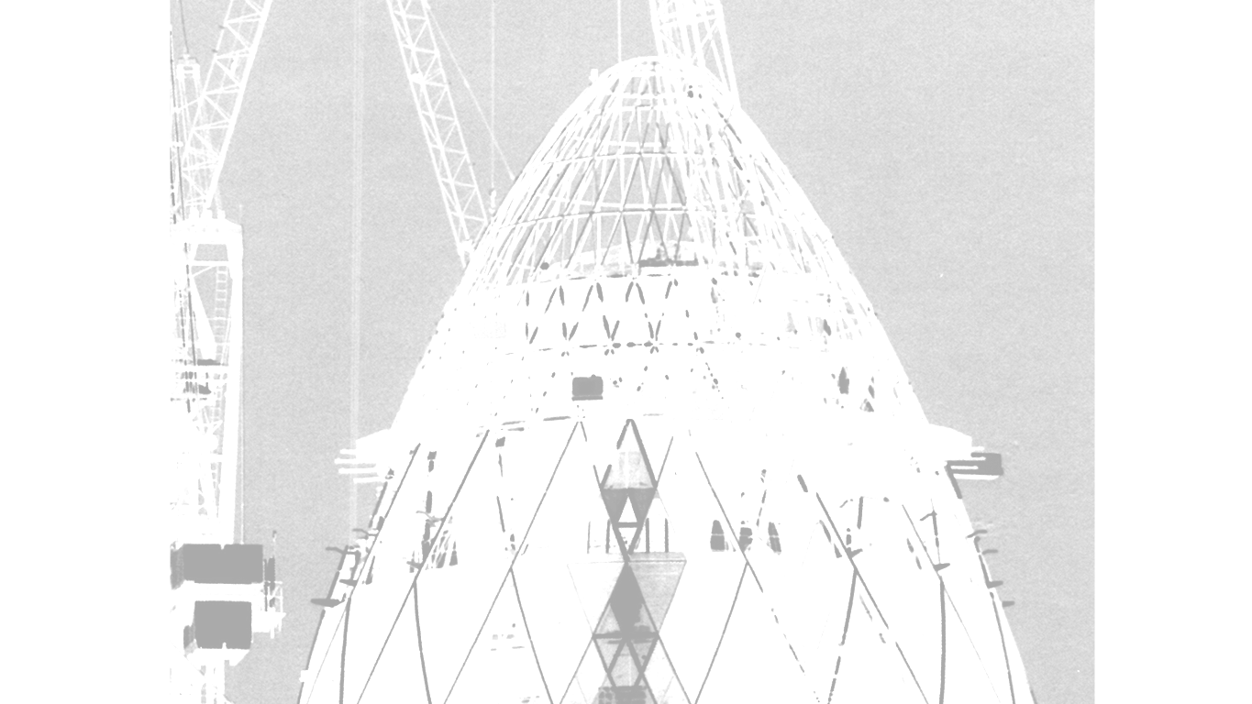
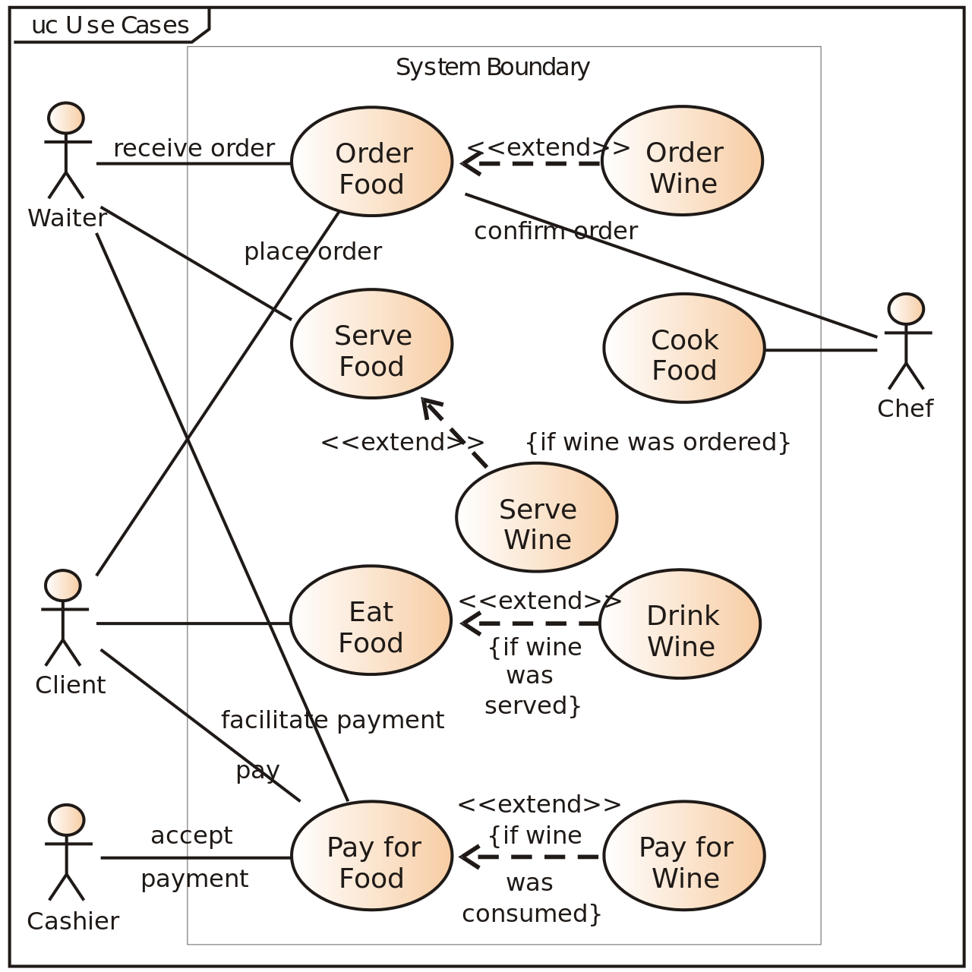
Restaurant
Notes:
As a customer, I want to order some food
Eat and pay for the food
Extends is as an extra, might want to order some wine
Waitress takes the food
Serve the food an maybe the wine

Slide 15
Case-Based Simulation: Scenario
A Developer
Initiates a scenario by starting a new simulation
Adds text to the scenario story
Can add media to the scenario story
Adds a link to the next simulation “node.”
Starts scenario
Adds story text
Developer
Adds media
Adds
link

Slide 16
Case-Based Simulation: Scenario
Developer can save text to a server
Developer can save media to a server
Starts scenario
Adds story text
Saves story text
<<includes>>
Developer
Server
Adds media
Saves media
<<includes>>
Adds
link

Slide 17
Case-Based Simulation: Scenario
The simulation “structure” is saved as in XML
Starts scenario
Adds story text
Saves story text
<<includes>>
Developer
Server
Adds media
Saves media
<<includes>>
Adds
link
XML

Slide 18
Case-Based Simulation: Scenario
Edit media is an “extension” of the system function
Starts scenario
Adds story text
Saves story text
<<includes>>
Developer
Server
Adds media
<<includes>>
Saves media
<<extends>>
Edits media
Adds
link
XML

